Slide 1
Lecture 10 – CNN Applications and Tricks
Prof. André Gustavo Hochuli
gustavo.hochuli@pucpr.br
aghochuli@ppgia.pucpr.br
Notes:
Prof. André Hochuli

Slide 2
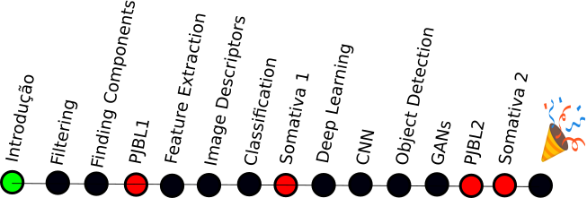
Topics
Review of Lecture 09
Convolutional Neural Network
Basic Concepts
Data Augmentation
Transfer-Learning
Applications
Practice
Computer Vision - Prof. André Hochuli
Lecture 10
Notes:
Prof. André Hochuli

Slide 3
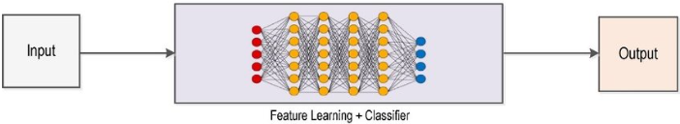
Deep Learning Pipeline
Computer Vision - Prof. André Hochuli
Lecture 10
Notes:
Prof. André Hochuli

Slide 4
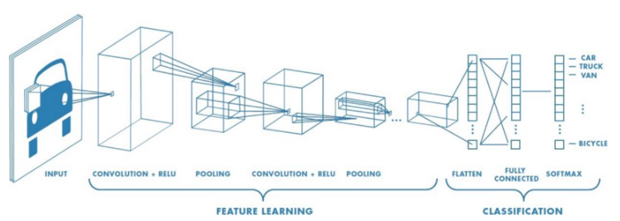
Convolutional Neural Network
CNN
Computer Vision - Prof. André Hochuli
Lecture 10
Notes:
Prof. André Hochuli

Slide 5
Convolutional Neural Network
Feature Extraction
Computer Vision - Prof. André Hochuli
Lecture 10
Notes:
Prof. André Hochuli

Slide 6
Convolutional Neural Network
Classification
Forward and Back Propagation
Computer Vision - Prof. André Hochuli
Lecture 10
Notes:
Prof. André Hochuli

Slide 7
Convolutional Neural Network
Forward and Back Propagation
Computer Vision - Prof. André Hochuli
Lecture 10
Notes:
Prof. André Hochuli

Slide 8
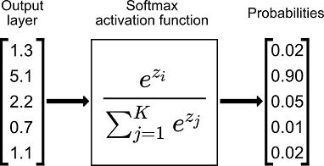
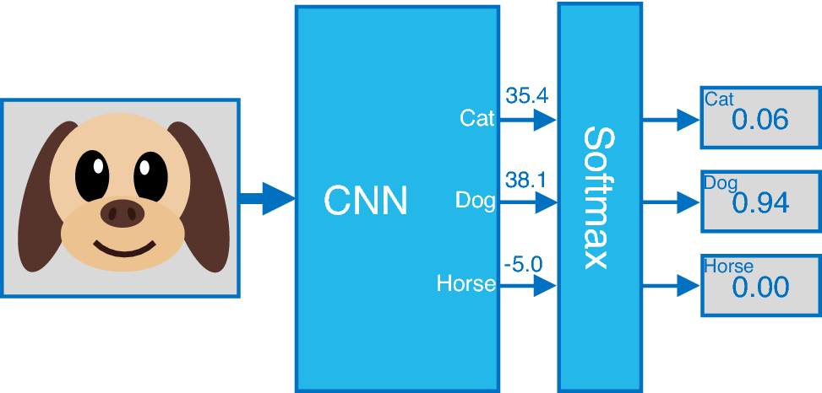
Convolutional Neural Network
Softmax
Computer Vision - Prof. André Hochuli
Lecture 10
Notes:
Prof. André Hochuli

Slide 9
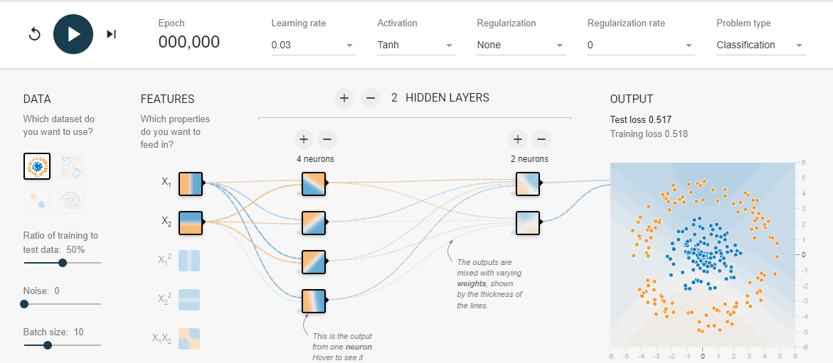
Convolutional Neural Network
Tensorflow Playground
https://playground.tensorflow.org/
Computer Vision - Prof. André Hochuli
Lecture 10
Notes:
Prof. André Hochuli

Slide 10
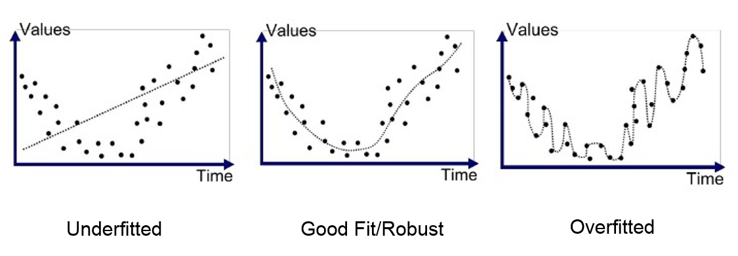
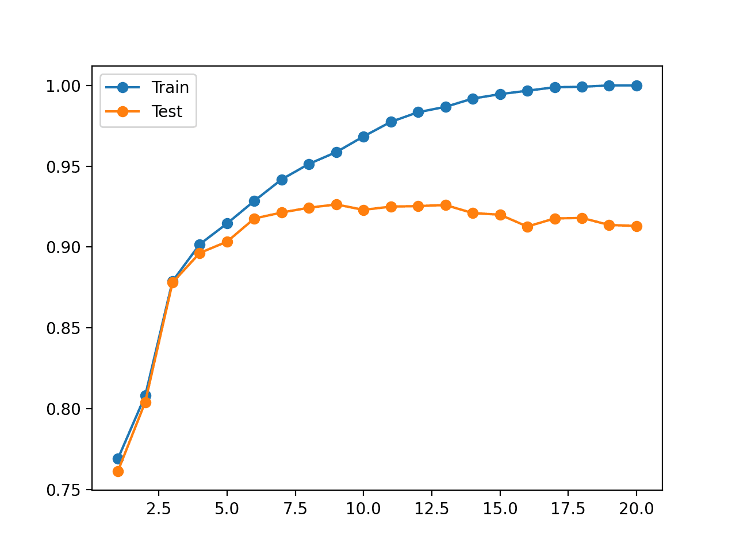
Overfitting
Bad generalization
Computer Vision - Prof. André Hochuli
Lecture 10
Notes:
Prof. André Hochuli

Slide 11
Overfitting
Bad generalization
Computer Vision - Prof. André Hochuli
Lecture 10
Notes:
Prof. André Hochuli

Slide 12
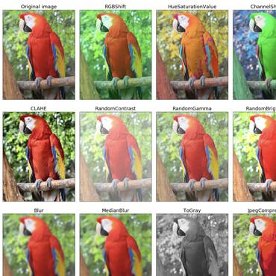
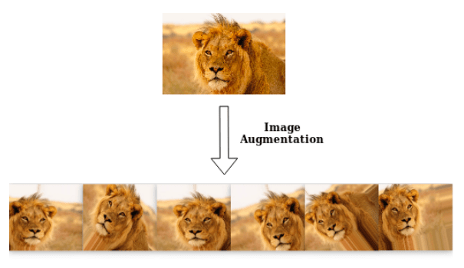
Data Augmentation
Enlarge the dataset with synthetic samples
Computer Vision - Prof. André Hochuli
Lecture 10
Notes:
Prof. André Hochuli

Slide 13
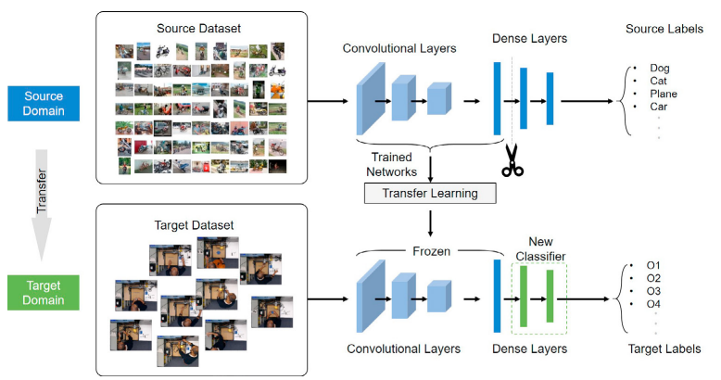
Transfer Learning
Weight Sharing
Feature Extraction weights are frozen (or not...) during learning
Computer Vision - Prof. André Hochuli
Lecture 10
Notes:
Prof. André Hochuli

Slide 14
Let’s Code
[LINK]
Assessment Task: PJBL-3 at Canvas
Delivery date: 06/11 23:59
Computer Vision - Prof. André Hochuli
Lecture 10
Notes:
Prof. André Hochuli

